Slide 1
Feedfusion
The Social Handle Aggregator

Slide 2
Group Members
Srajan Soni (0801CS141083)
Suryansh Soni (0801CS141086)
Satyam Khandekar (0801CS141073)
Rishabh Panwar (0801CS141066)

Slide 3
Acknowledgement
We have taken efforts in this project. However, it would not have been possible without the kind support and help of institution. We would like to extend my sincere thanks to all of them.
We are highly indebted to Mr. Lokendra Vishwakarma Sir for their guidance and constant supervision as well as for providing necessary information regarding the project & also for their support in completing the project.

Slide 4
Introduction
The Social Handle Aggregator is designed in such a way that it aids people of all ages, gender and nationality to view social media feeds at one screen.
This system aims to provide a one stop experience of social feeds,and posting contents to social networks in one go.
Such type of systems are especially helpful for online presence manager.
This system is intended to reduce time wastage and make it easier and user friendly.

Slide 5
Motive behind this?

Slide 6
Objective
Feedfusion provides a platform for one stop for all social applications.
To provide a secure gateway to social media handles.

Slide 7
What all is needed to run?

Slide 8
Hardware Requirements
Processor : Intel core i3 and above
Processor speed : 1.4 GHz and above
System Memory : 512 Mb (Minimum)
RAM : 1 GB (Minimum), 2GB (recommended)
Network Card : Any card that can provide 100 Mbps speed
Network connection: UTP or Coaxial Cable connection

Slide 9
Software Requirements
Front End : HTML, CSS, JavaScript, Angular JS.
Back End : Node JS, Java Servlets with Tomcat as Server,OAuth access to social media sites,a global IP address at which these sites could callback..

Slide 10
The Major Creativity..

Slide 11
Features
Adding various platforms
Upon creating an account and logging in, the user is supposed to add various social media handles whose feeds he want to view in the application all at once rather than switching back and forth on various platforms

Slide 12
Features
Unified Feeds
Upon adding various social platforms, the landing page is the one in which an aggregated feed will be there for the user to view. The user can like, share and comment exactly like he would do on any of the individual platforms.

Slide 13
Who all would be using this?

Slide 14
Intended Users
Users :
Any person who has registered and has account on Facebook and Twitter.
Any person seeking to use the system can view all his feeds through one software across social platforms.
He can also post to networks simultaneously in one go.

Slide 15
Why Social Handle Aggregator?

Slide 16
Purpose
Easy to handle with user friendly interface.
Efficient data management and manipulation.
Time saving.

Slide 17
A Practical View..

Slide 18
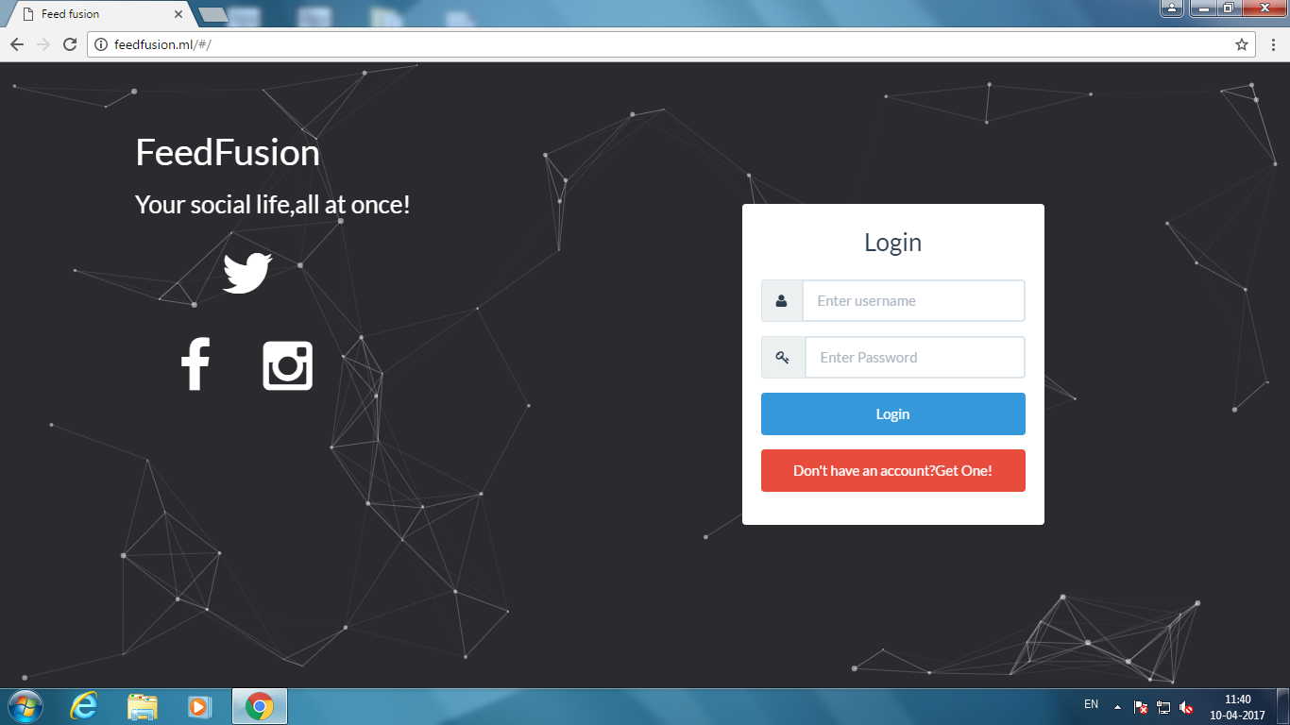
Front Page

Slide 19
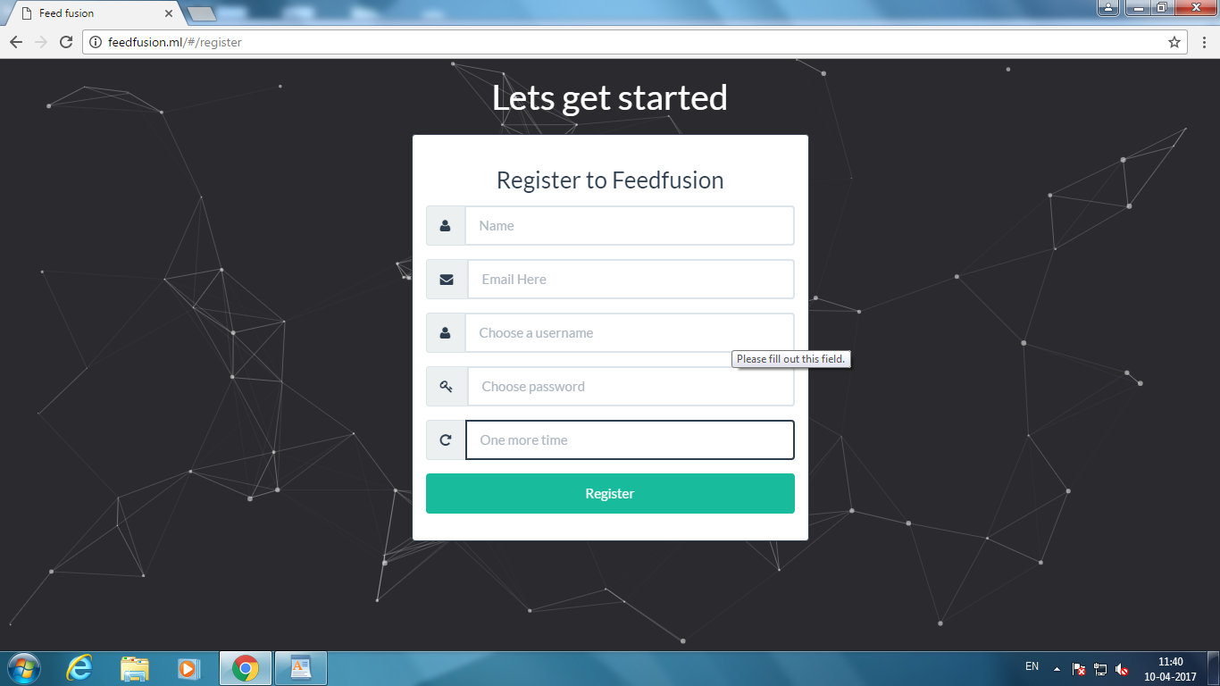
Registration Page

Slide 20
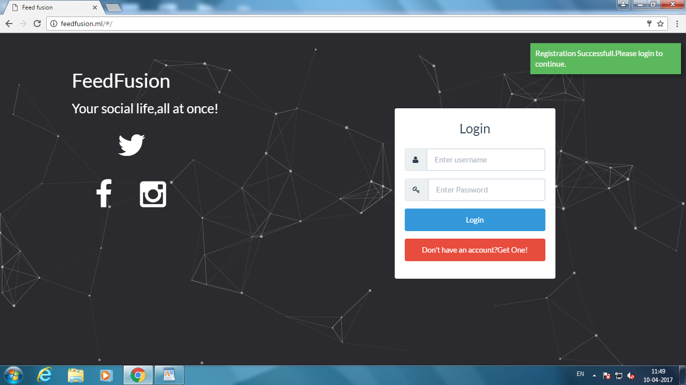
Successful Registration

Slide 21
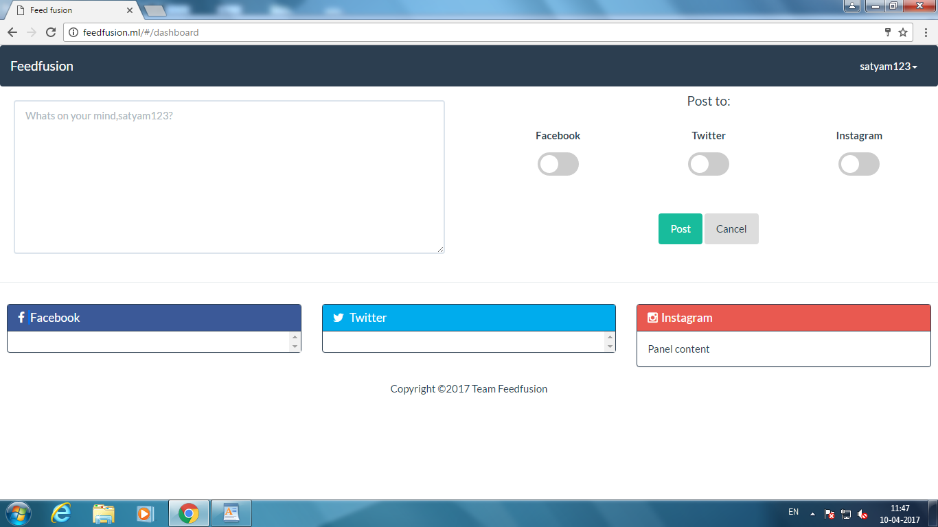
Successful Login

Slide 22
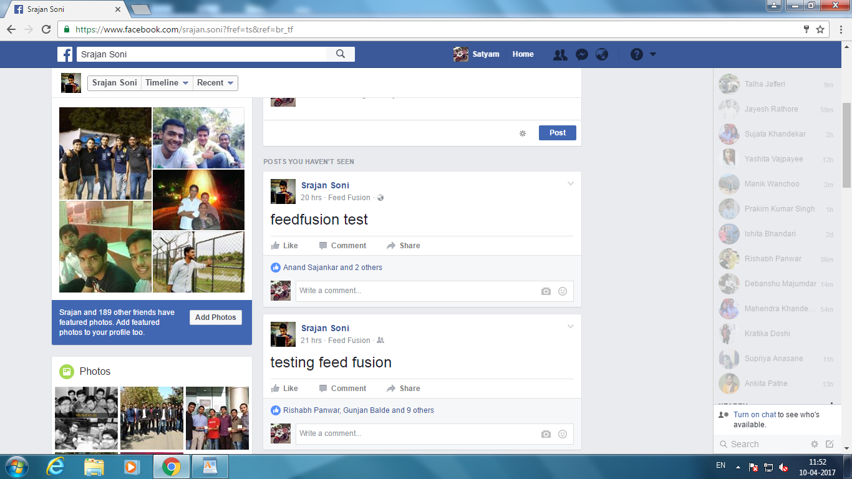
Successfully Posted on Facebook through FeedFusion

Slide 23
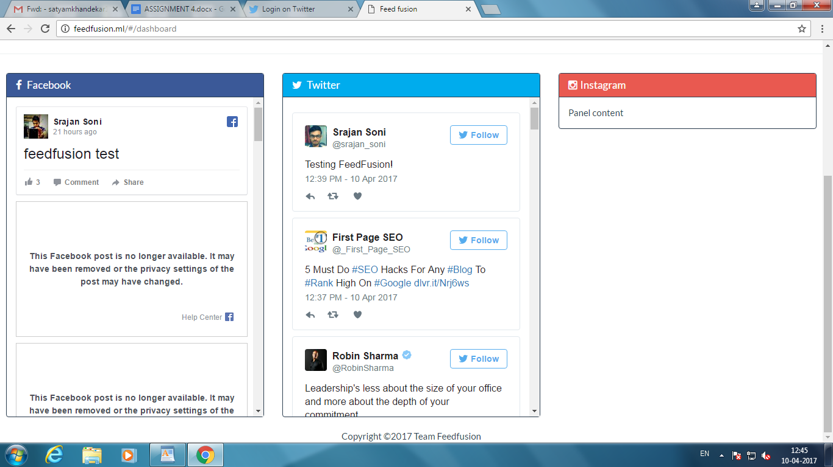
Posts displayed on Dashboard

Slide 24
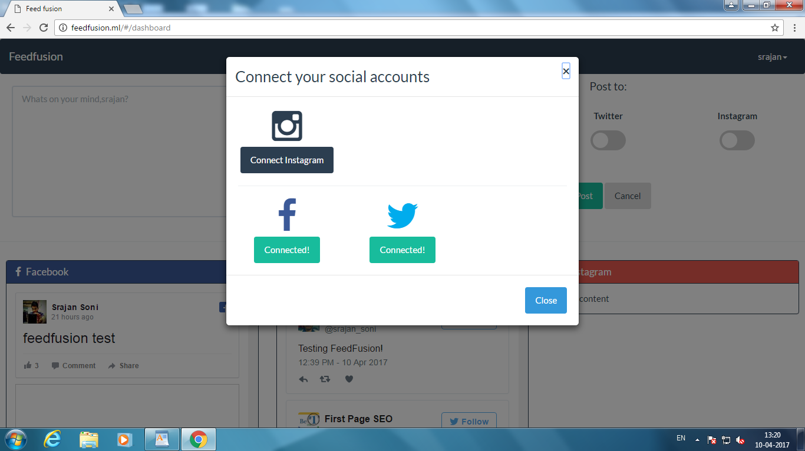
Managing and connecting social platforms

Slide 25
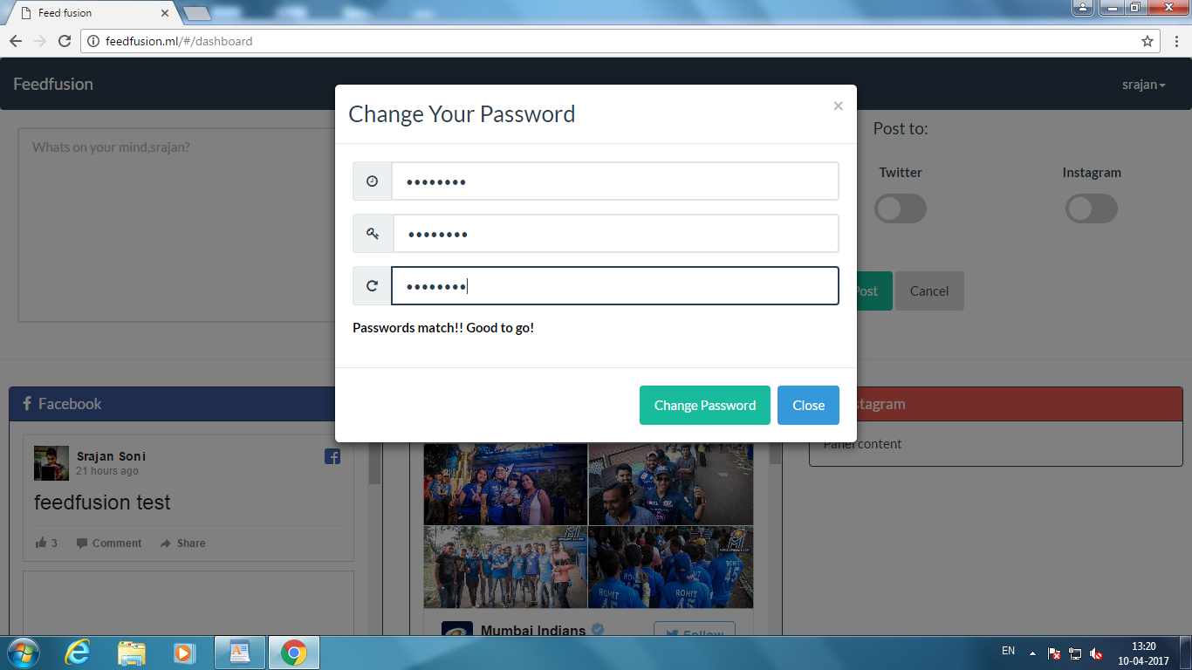
Password change

Slide 26
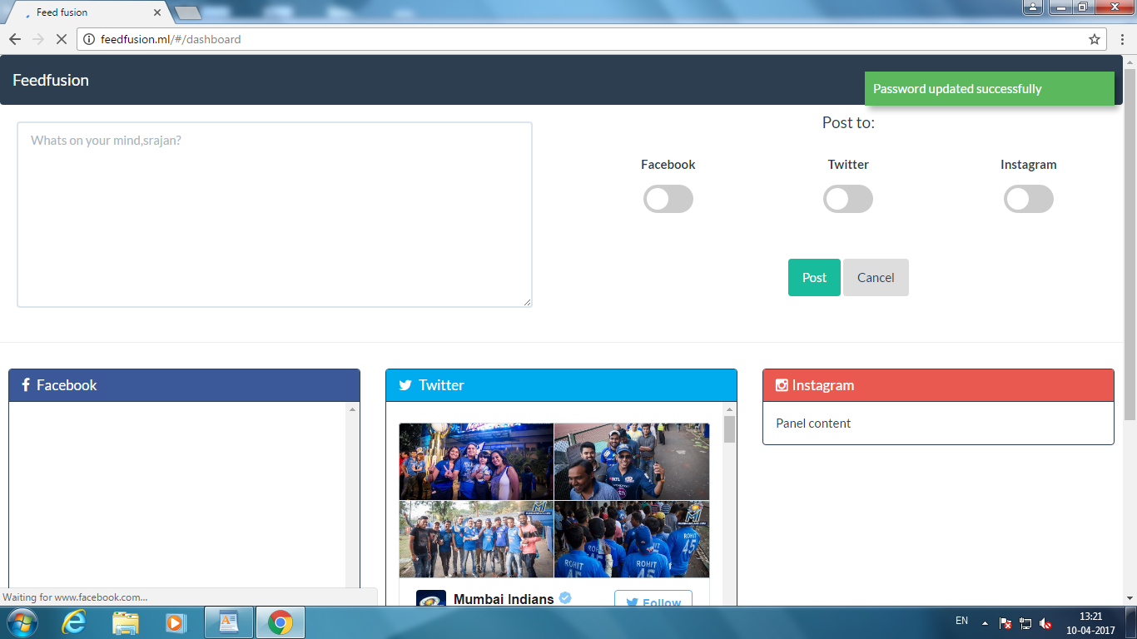
Password changed successfully

Slide 27
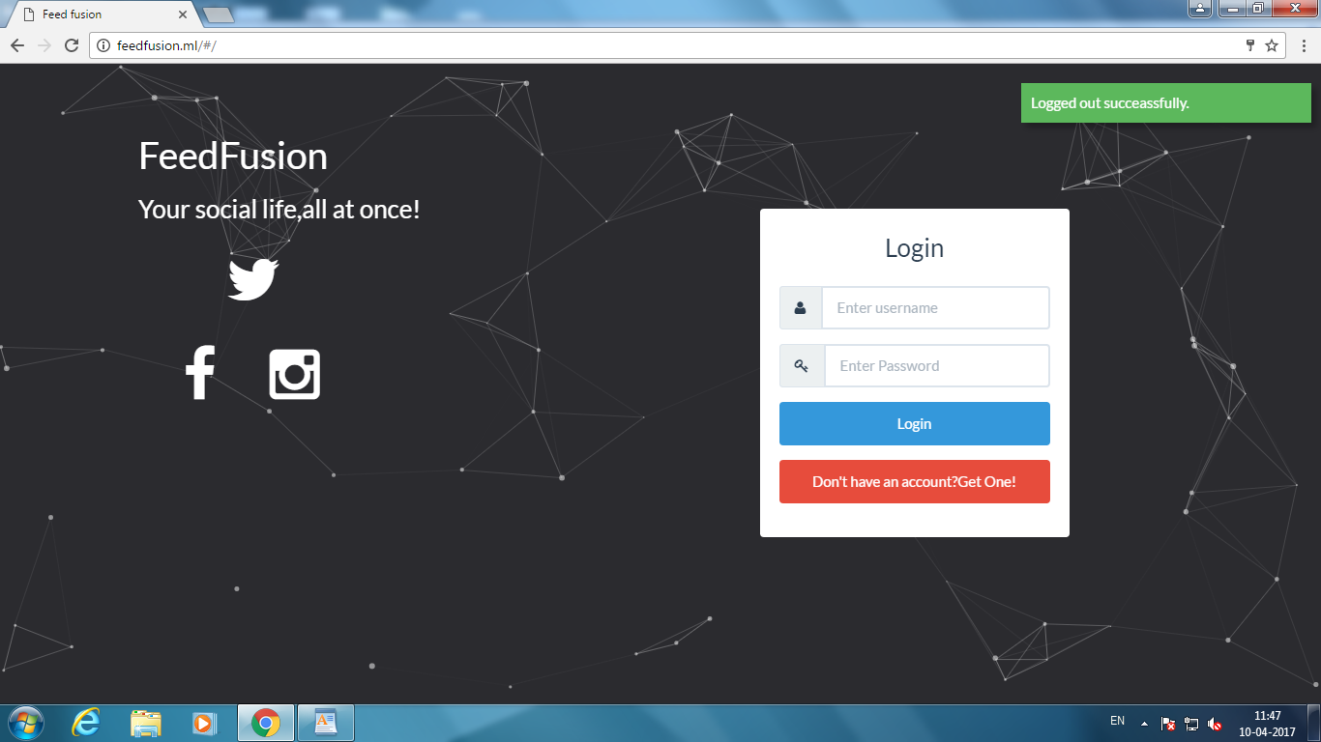
Successful Logout

